Slide 2
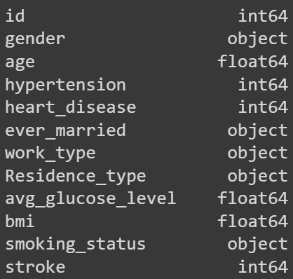
The attributes and their types

Slide 3
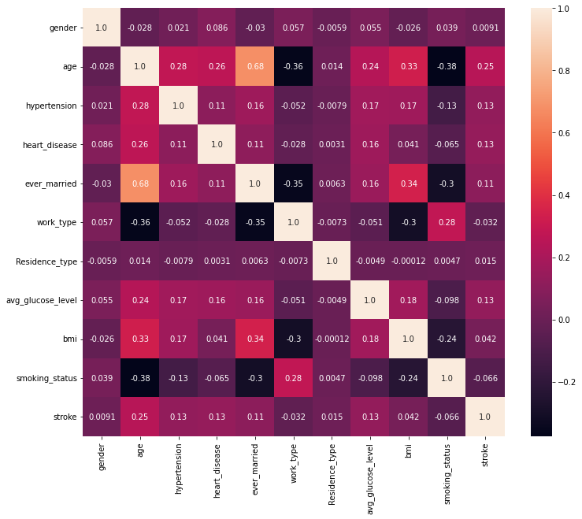
Correlation matrix

Slide 4
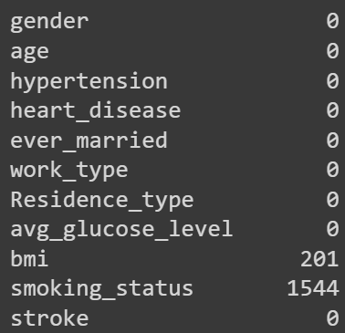
Null Values

Slide 5
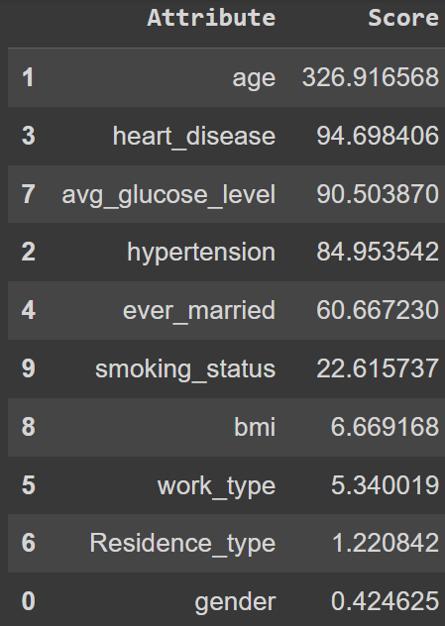
Attributes affecting Stroke the most

Slide 6
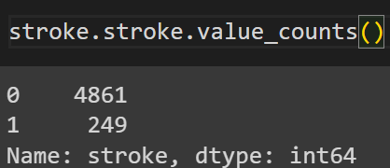
SMOTE

Slide 7
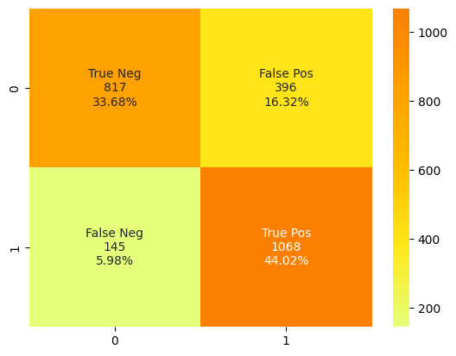
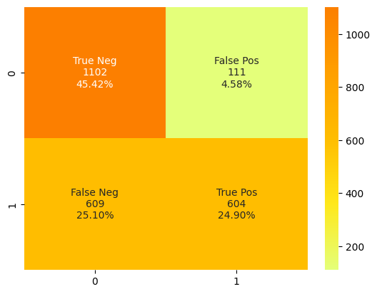
Random Forest Classifier
Naïve-Bayes Classifier
Accuracy: 77.69991 %
Accuracy: 70.32151 %

Slide 8
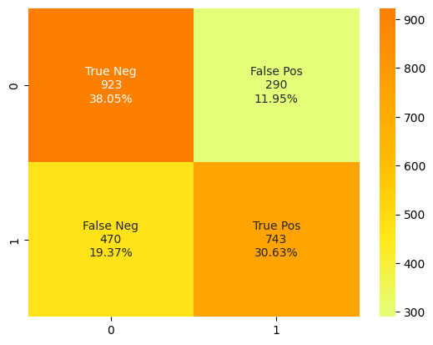
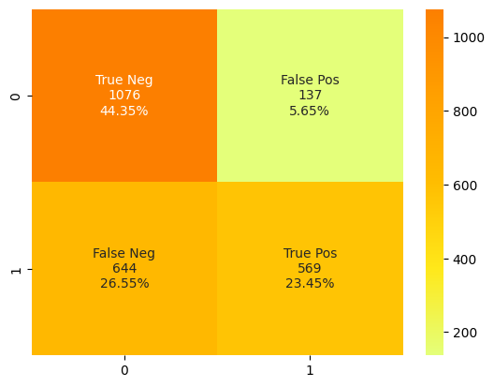
Decision Tree Classifier
KNN Classifier
Accuracy: 68.67271 %
Accuracy: 67.80708 %

Slide 9
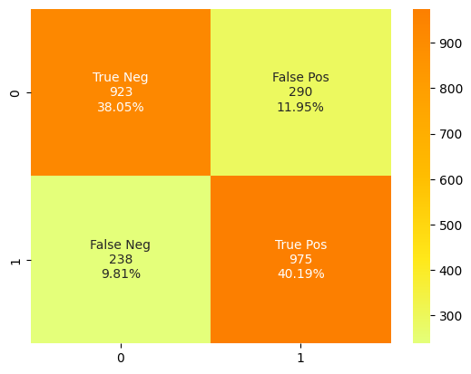

Logistic Regression
Support Vector Classifier
Accuracy: 77.24649 %
Accuracy: 78.23577 %

Slide 10
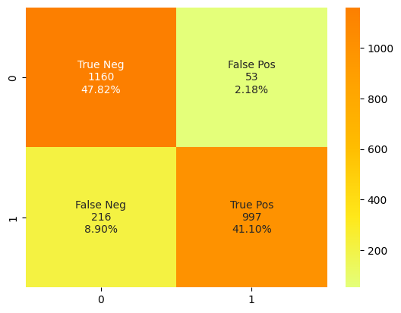
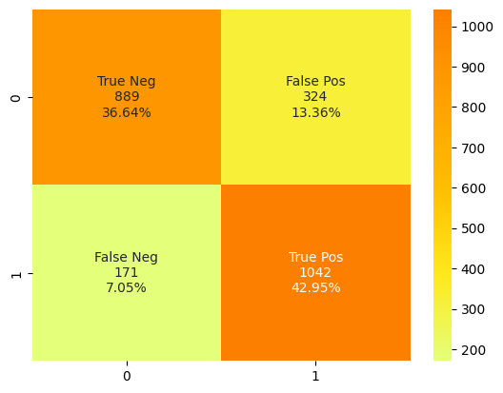
AdaBoost Regression
XGBoost Classifier
Accuracy: 88.91178 %
Accuracy: 79.59604 %

